Slide 1
Two Dimensional Algorithm

Slide 2
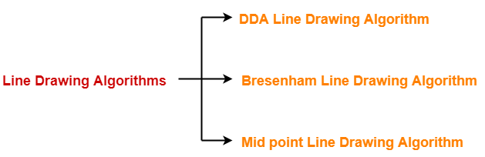
Line Scan Conversion
In computer graphics, we need to represent continuous graphics objects using discrete pixels. This process is known as scan conversion.
Every graphics system must transform the primitives like lines, circles, and ellipses into a collection of pixels.
Line drawing algorithms are used to draw a line in discrete graphical media. There are three line drawing algorithms in computer graphics.

Slide 3
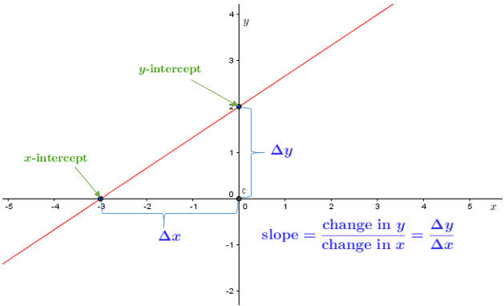
The Line Equation
Finding the next pixel to draw a line
We need two endpoints, P and Q, to draw a line on a raster screen. We are starting from the P coordinate and find the next pixels until we reach the endpoint Q.

Slide 4
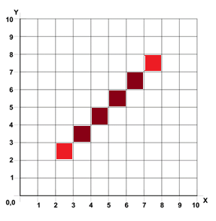
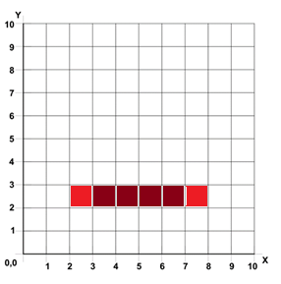
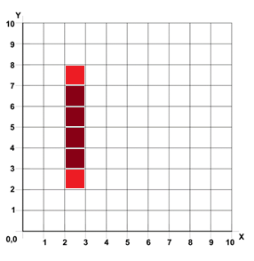
There are three special scenarios when we draw lines.
Case 1: Draw a Horizontal Line: m = 0
The horizontal line has the same Y coordinate value. In this scenario, we only need to consider X coordinate value changes. We first draw pixel P and increment only the X coordinate value by 1 to get the next pixel.
Case 2: Draw a Vertical Line:
m is undefined
Vertical lines have the same X coordinates values and different Y coordinate values. Similar to the horizontal line draw, we first draw the initial pixel (P), and this time we increment Y coordinate values by 1 to get the next pixel until we reach endpoint Q.
Case 3: Draw a Diagonal Line: m = 1
The final special scenario is to draw a diagonal line, where the slope equals 1. To get the next pixel in diagonal line we need to increment both X and Y coordinate values by 1.

Slide 5
DDA Algorithm
DDA stands for Digital Differential Analyzer.
This is an incremental line algorithm, the calculation of each step is based on the results of the previous steps.
Step-01:
Calculate ΔX, ΔY and M from the given input.
These parameters are calculated as-
ΔX = X_{n} – X₀
ΔY =Y_{n} – Y₀
M = ΔY / ΔX
Step-02:
Find the number of steps or points in between the starting and ending coordinates.
if (absolute (ΔX) > =absolute (ΔY))
Steps = absolute (ΔX);
else
Steps = absolute (ΔY);

Slide 6
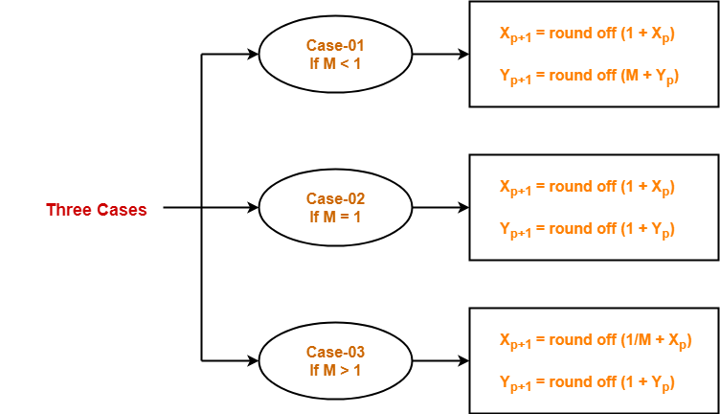
Step-03:
Suppose the current point is (X_{p}, Y_{p}) and the next point is (X_{p+1}, Y_{p+1}).
Find the next point by following the below three cases-
Step-04:
Keep repeating Step-03 until the end point is reached or the number of generated new points (including the starting and ending points) equals to the steps count.

Slide 7
Q. A line has a starting point (1,7) and ending point (11,17). Apply the DDA algorithm to plot a line.
Solution:
We have two coordinates,
Starting Point = (x₁, y₁) = (1,7)
Ending Point = (x₂, y₂) = (11,17)
Step 1: First, we calculate Δx, Δy and m.
Δx = x₂ – x₁ = 11-1 = 10
Δy = y₂ – y₁ = 17-7 = 10
m = Δy/Δx = 10/10 = 1
Step 2: Now, we calculate the number of steps.
Δx = Δy = 10
Then, the number of steps = 10
Step 3: We get m = 1, Second case is satisfied.
Now move to next step.

Slide 8
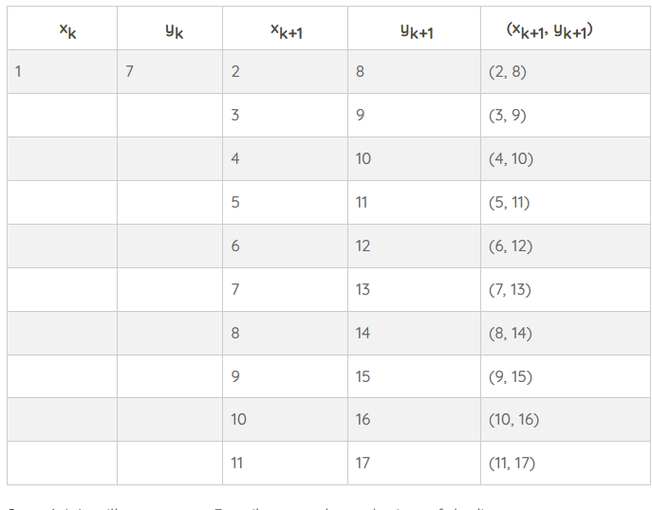

Slide 9
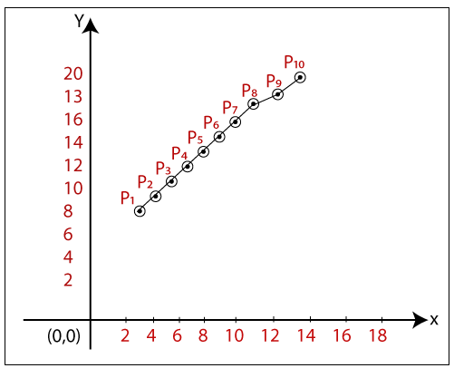
The coordinates of drawn line are-
P₁ = (2, 8)
P₂ = (3, 9)
P₃ = (4, 10)
P₄ = (5, 11)
P₅ = (6, 12)
P₆ =(7,13) P₇ = (8, 14)
P₈ = (9, 15)
P₉ = (10, 16)
P₁₀ = (11, 17)
Advantages of Digital Differential Analyzer
It is a faster algorithm than the direct line equation.
We cannot use the multiplication method in Digital Differential Analyzer.
Digital Differential Analyzer algorithm tells us about the overflow of the point when the point changes its location.
Disadvantages of Digital Differential Analyzer
The floating-point arithmetic implementation of the DDA is time-consuming.
The method of round-off is also time-consuming.
Sometimes the point position is not accurate.

Slide 10
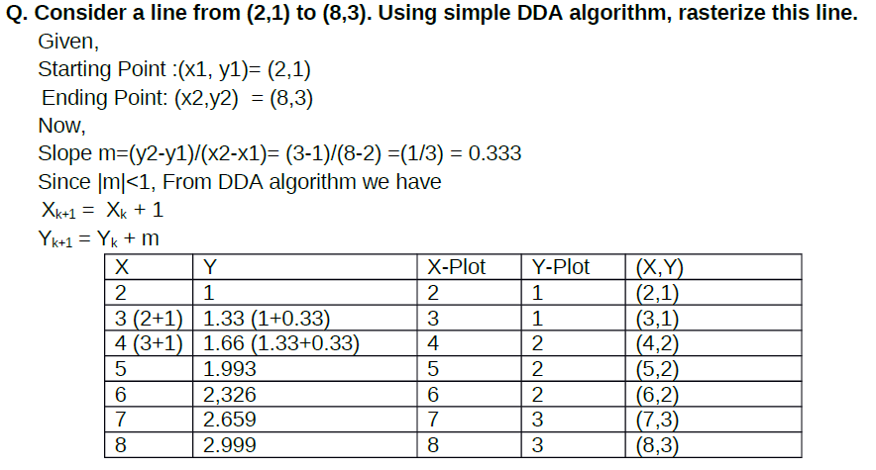

Slide 11
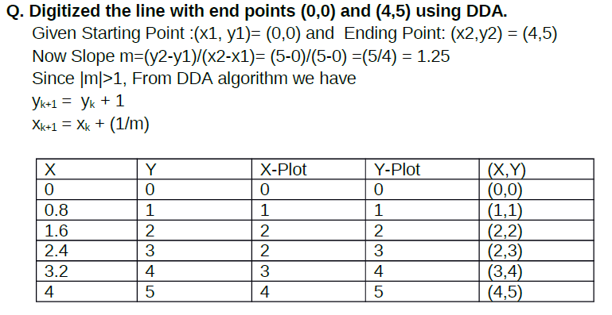

Slide 12
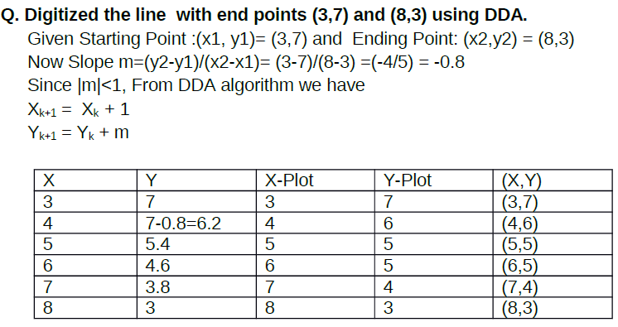

Slide 13
Exercise-1
1.Digitize the line from A(1,1) to B(10,8) using scan conversion line algorithm.
2. Draw a line with two end point P(5,3) and Q(1,2) using DDA
3. Digitize the line with endpoints A(1,7) and B(6,3) using digital differential analyzer line drawing algorithm. Show all necessary steps. (TU 2013, 3 marks) .
4. Digitize the line with end points (1,2) and (5,6) using digital differential analyzer method.(TU 2012, 3 marks).
5. Digitize the given line endpoints (1,1) and (5, 5) using DDA.
6. Draw a line using DDA with two end points A(0,0) and B(-10,8).
7. Digitize line with start at (5,3) and end at (1,5) using DDA.
8. Digitize DDA with all necessary steps with two end points (0,0) and (10,0).

Slide 14
Bresenham Line Drawing Algorithm
• The BLA is a more efficient method used to plot pixel position along a straight-line path.
Advantage of BLA over DDA
• In DDA algorithm each successive point is computed in floating point, so it requires more time and more memory space. While in BLA each successive point is calculated in integer value or whole number. So it requires less time and less memory space.
• In DDA, since the calculated point value is floating point number, it should be rounded at the end of calculation but in BLA it does not need to round, so there is no accumulation of rounding error. • Due to rounding error, the line drawn by DDA algorithm is not accurate, while in BLA line is accurate.
• DDA algorithm cannot be used in other application except line drawing, but BLA can be implemented in other application such as circle, ellipse and other curves.

Slide 15
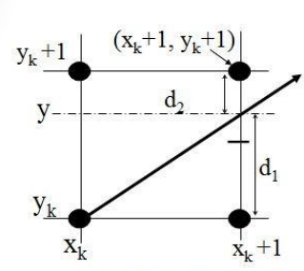
BLA
Let us assume that pixel (xk , yk ) is already plotted assuming that the sampling direction is along X-axis i.e. (xk+1, yk ) or (xk+1, yk+1).
Thus, the common equation of the line is y = m(xk+1) + c
Now,
d1 = y - yk = m (xk +1) + c - yk
d2 = (yk +1)- y = yk+1– {m (xk +1) + c }

Slide 16
The difference betn these two separation is,
d1 - d2 = [m (xk +1) + c - yk ] - [yk+1– {m (xk +1) + c }]
Or,
d1- d2 = 2m (xk+1)+ 2c - 2yk -1
Since, slope of line (m) = Δy / Δx,
We have,
Δx (d1- d2) = 2 Δy (xk+1)+ 2 Δx C - 2 Δx Yk – Δx
Define Decision parameter at Kth step,
Pk = Δx (d1- d2)
= 2 Δy (xk+1)+ 2 Δx C - 2 Δx yk – Δx
=2 Δy Xk+2 Δy + 2 Δx c - 2 Δx yk – Δx

Slide 17
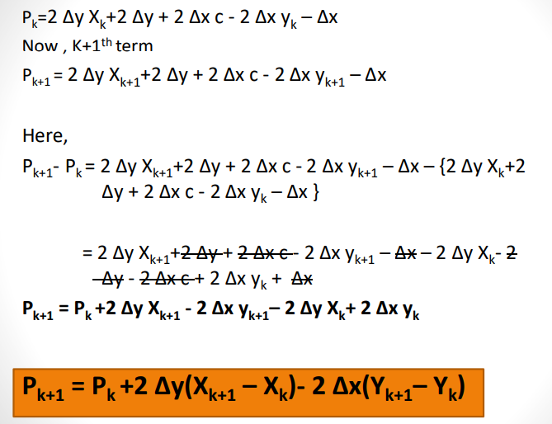

Slide 18
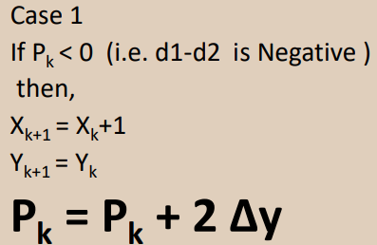
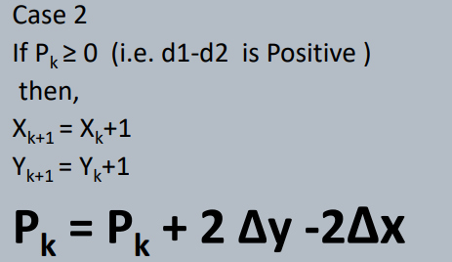
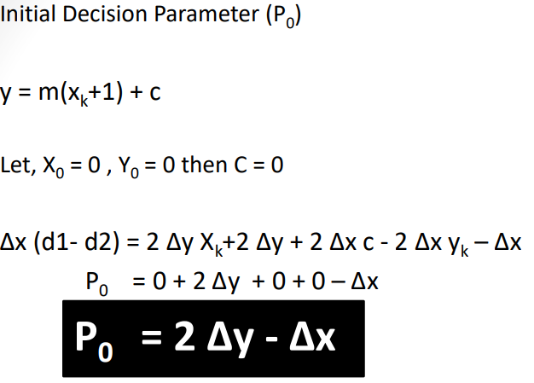

Slide 19
Summary of BLA
Given-
Starting coordinates = (X₀, Y₀)
Ending coordinates = (X_{n}, Y_{n})
Step-01:
Calculate ΔX and ΔY from the given input.
These parameters are calculated as-
ΔX = X_{n} – X₀
ΔY =Y_{n} – Y₀
Step-02:
Calculate the decision parameter P_{k}.
It is calculated as-
P_{k} = 2ΔY – ΔX

Slide 20
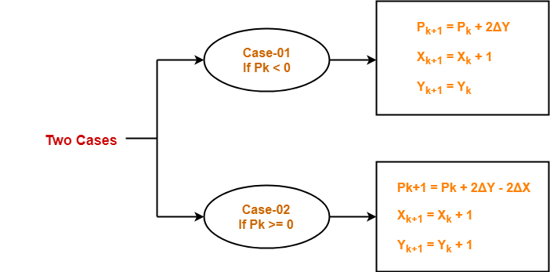
Step-03:
Suppose the current point is (X_{k}, Y_{k}) and the next point is (X_{k+1}, Y_{k+1}).
Find the next point depending on the value of decision parameter P_{k}.
Follow the below two cases-
Step-04:
Keep repeating Step-03 until the end point is reached or number of iterations equals to (ΔX-1) times.

Slide 21
Problem-01:
Calculate the points between the starting coordinates (9, 18) and ending coordinates (14, 22).
Solution-
Given-
Starting coordinates = (X₀, Y₀) = (9, 18)
Ending coordinates = (X_{n}, Y_{n}) = (14, 22)
Step-01:
Calculate ΔX and ΔY from the given input.
ΔX = X_{n} – X₀ = 14 – 9 = 5
ΔY =Y_{n} – Y₀ = 22 – 18 = 4
Step-02:
Calculate the decision parameter.
P_{k}
= 2ΔY – ΔX
= 2 x 4 – 5
= 3
So, decision parameter P_{k} = 3

Slide 22
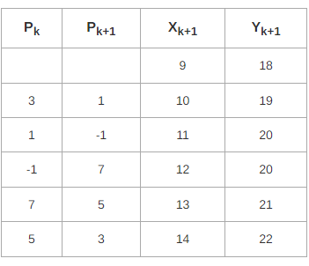
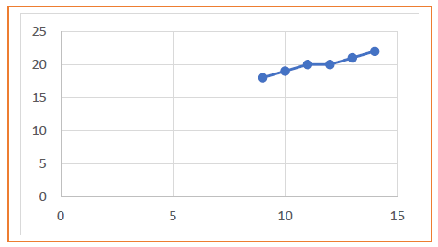
Step-03:
As P_{k} >= 0, so case-02 is satisfied.
Thus,
P_{k+1} = P_{k} + 2ΔY – 2ΔX = 3 + (2 x 4) – (2 x 5) = 1
X_{k+1} = X_{k} + 1 = 9 + 1 = 10
Y_{k+1} = Y_{k} + 1 = 18 + 1 = 19
Similarly, Step-03 is executed until the end point is reached or number of iterations equals to 4 times.
(Number of iterations = ΔX – 1 = 5 – 1 = 4)

Slide 23
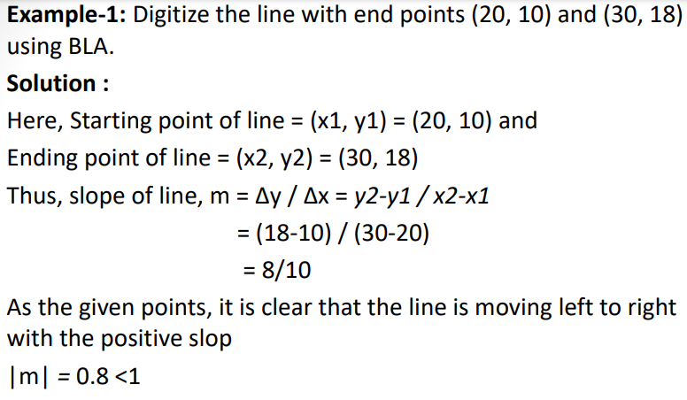
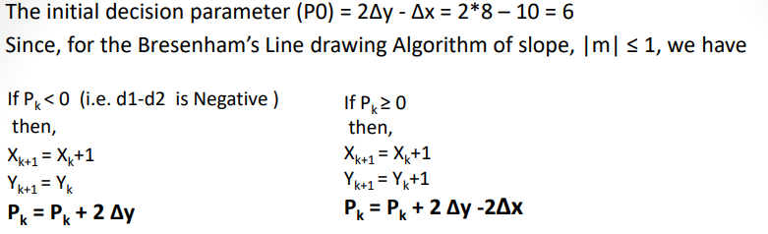

Slide 24
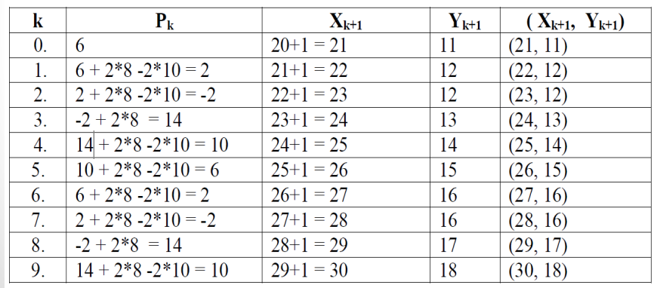
Example-2: Digitize the line with end points (15, 5) and (30, 10) using BLA.
Example-3: Digitize the line with end points (20, 5) and (25, 10) using BLA.

Slide 25
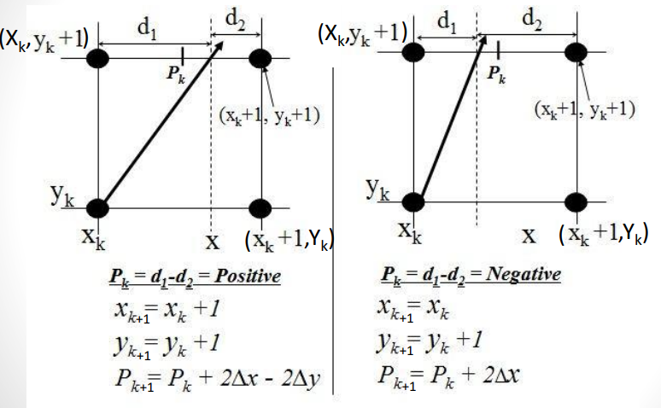
BLA for slope +ve and |m| > 1

Slide 26
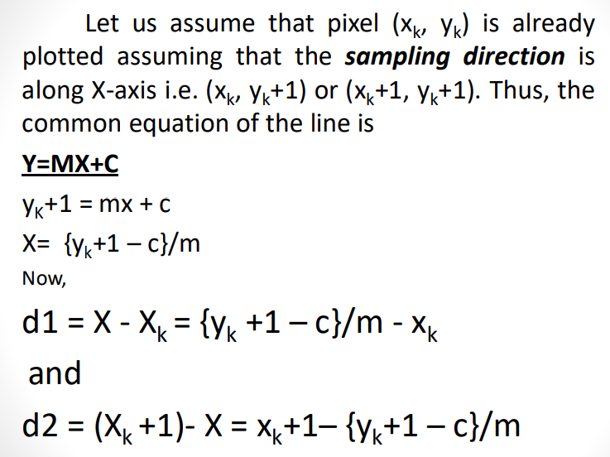

Slide 27
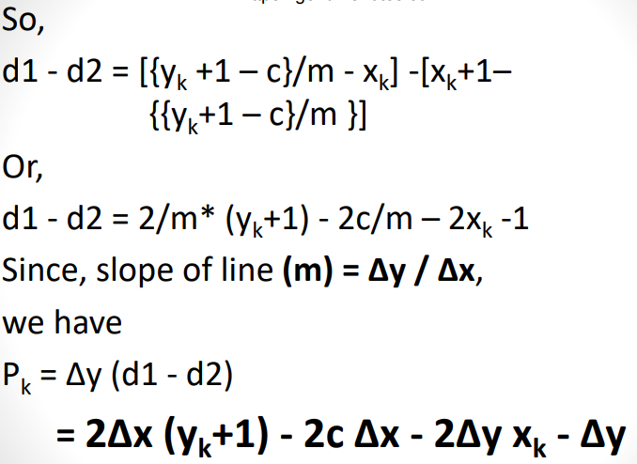

Slide 28
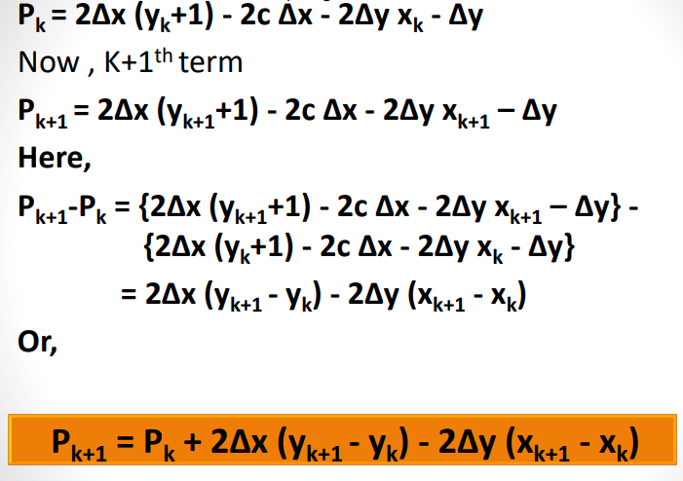

Slide 29
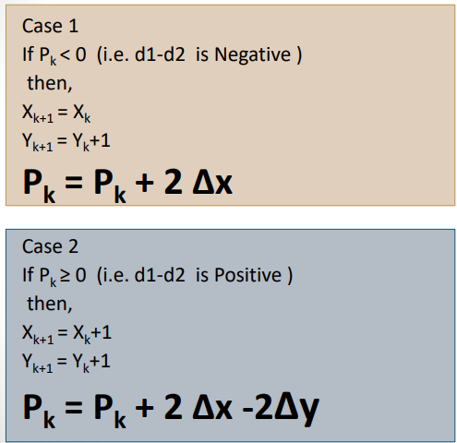
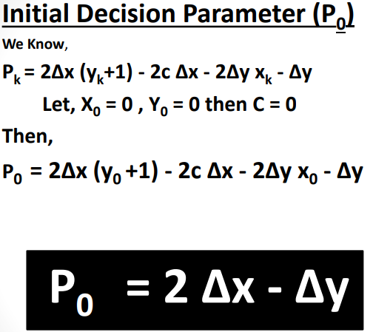

Slide 30
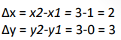
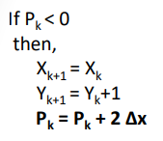
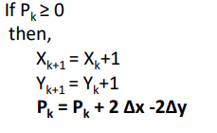
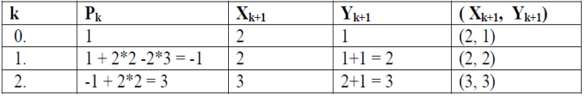
Example: Digitize the line with end points (1, 0) and (3, 3) using BLA
Solution :
Here, Starting point of line = (x1, y1) = (1, 0)
Ending point of line = (x2, y2) = (3, 3)
Thus, slope of line, m = Δy / Δx = y2-y1 / x2-x1 = (3-0) / (3-1) = 3/2
As the given points, it is clear that the line is moving left to right with the positive slope, |m| = 1.5 >1
Thus, the initial decision parameter (P0) = 2Δx - Δy = 2*2 – 3 = 1
we have

Slide 31
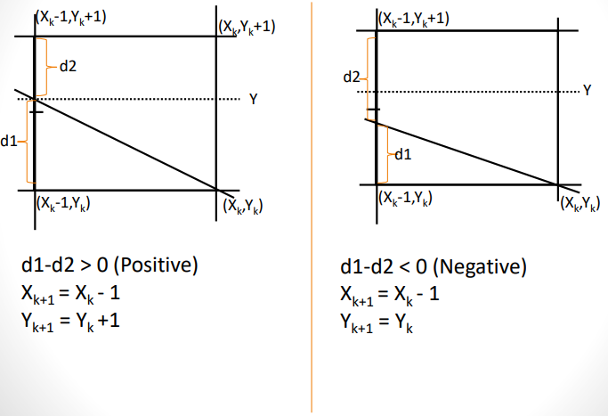
Slope –Ve and |M| ≤ 1

Slide 32
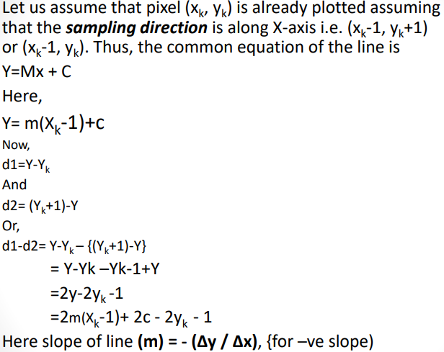

Slide 33
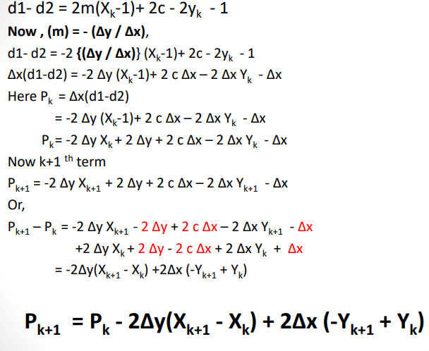

Slide 34
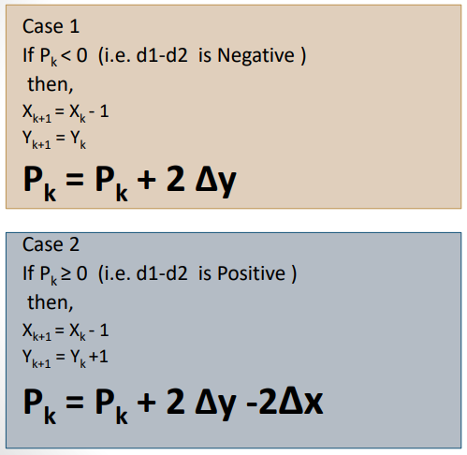
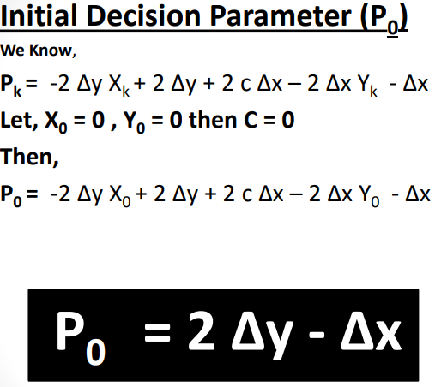

Slide 35
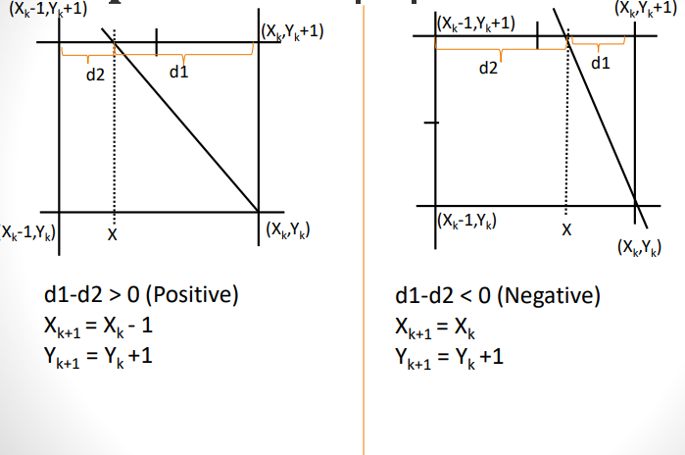
Slope –Ve and |M| > 1

Slide 36
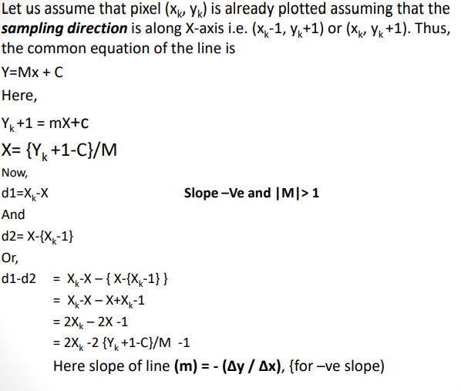

Slide 37
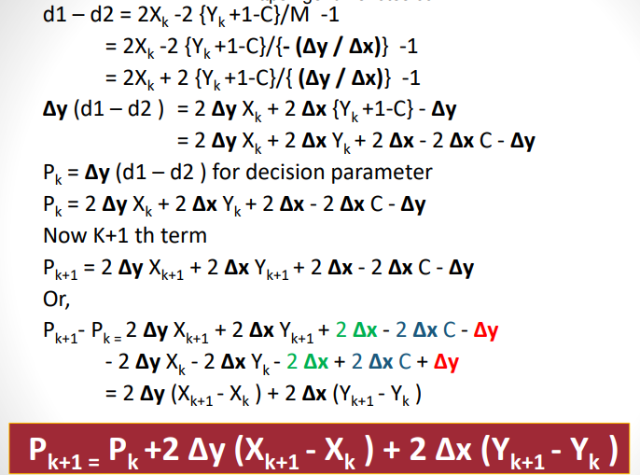

Slide 38
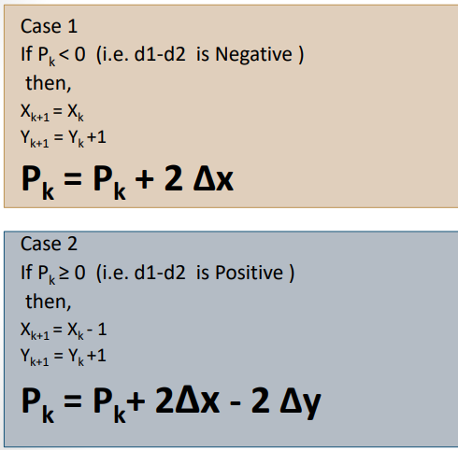
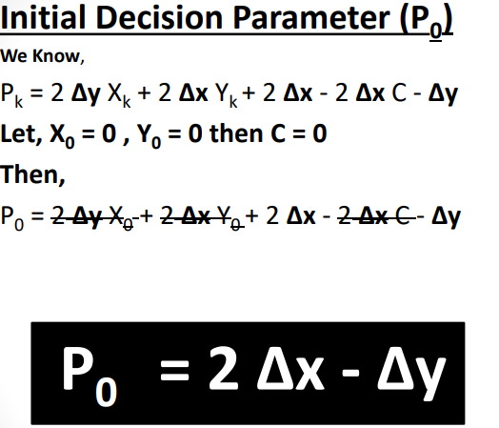

Slide 39
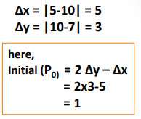
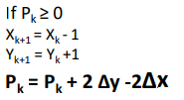
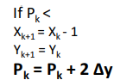
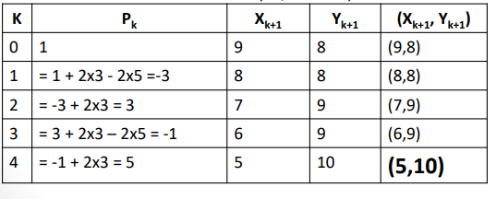
Example: Digitize the given line endpoints (5, 10) and (10, 7) using BLA.
Solution: Here, (X1 ,Y1 )= (10,7) &
(X2 ,Y2 )=(5,10)
M= (10-7)/(5-10) = -3/5 –ve slope and |M| < 1

Slide 40
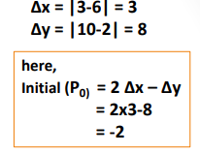
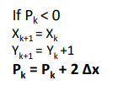
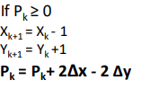
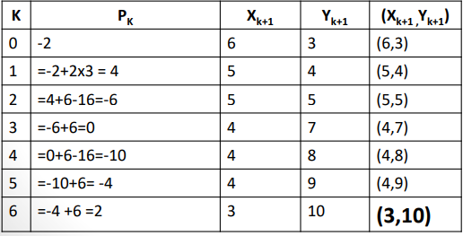
Example: Digitize line with endpoints (3, 10) and (6,2) using BLA.
Solution: Here, (X1 ,Y1 )= (6,2)
& (X2 ,Y2 )=(3,10)
M= (10-2)/(3-6) = 8/-3 –ve slope and |M| > 1

Slide 41

Example: Digitize the given line endpoints (15, 15) and (10, 18) using BLA.

Slide 42

Example: Digitize the given line endpoints (10, 10) and (20, 5) using BLA.

Slide 43


Circle Algorithm
• Similarly to the case with lines, there is an incremental algorithm for drawing circles – the mid-point circle algorithm
• In the mid-point circle algorithm we use four-way and eight-way symmetry so only ever calculate the points for the top right eighth of a circle, and then use symmetry to get the rest of the points

Slide 44
Mid-point circle algorithm
For a given radius r and screen center position (x_{c}, y_{c}), we can first set up our algorithm to calculate pixel positions around a circle path centered at the coordinate origin ( 0, 0 ).
Then each calculated position (x, y) is moved to its proper screen position by adding x_{c} to x and y_{c} to y.
Along the circle section from x = 0 to x = y in the first quadrant, the slope of the curve varies from 0 to - 1.
Therefore, we can take unit steps in the positive x direction over this octant and use a decision parameter to determine which of the two possible y positions is closer to the circle path at each step.
Positions in the other seven octants are then obtained by symmetry.
To apply the midpoint method. we define a circle function:
f_{circle}(x, y) = x² + y² – r²
Any point (x, y) on the boundary of the circle with radius r satisfies the equation f_{circle}( x, y ) = 0.
If f_{circle}( x, y ) < 0, the point is inside the circle boundary ,
If f_{circle}( x, y ) > 0, the point is outside the circle boundary,
If f_{circle}( x, y ) = 0, the point is on the circle boundary.

Slide 45


Clockwise direction
Suppose, set the pixel at
(x_{k} , y_{k} ),then next pixel (x_{k+1} , y_{k+1} ) will be either (x_{k} ₊ ₁, y_{k} ) or the pixel (x_{k + 1}, y_{k – 1}).
Here
mid point(m)= (x _{k + 1} , y_{k} – ½)
Since
m= ( $\frac{\text{x}\text{k} \text{+ 1 + }\text{x}\text{k} \text{+ 1}}{2}$, $\frac{\text{y}\text{k}\text{ + }\text{y}\text{k} \text{– 1}}{2}$ )

Slide 46


Slide 47


Slide 48

Calculate the initial decision parameter(P₀) for circle:-
The initial decision parameter is obtained by evaluation the circle function at the start position (x₀ , y₀) =(0,r)
Here, the next pixel will be either (1,r) or (1, r-1) then the mid-point is (1,r-1/2)
Now , initial decision parameter is given by:-
P₀ ₌f_{circle} (1,r-1/2)

Slide 49



Example : Digitize a circle with radius 10 at center (0,0)

Slide 50

Example : Digitize a circle with radius 8

Slide 51

Example: Digitize a circle with radius 9 and center at (6, 7).
Note: when center is not origin, we first calculate the octants points of the circle in the same way as the center at origin then add the given circle center on each calculated pixels.

Slide 52


Slide 53

Anti-Clockwise direction

Slide 54


Slide 55

Initial decision parameter
Many more…..Self Study

Slide 56
Summary of Mid-Point Circle Algorithm
Procedure-
Given-
Centre point of Circle = (X₀, Y₀)
Radius of Circle = R
The points generation using Mid Point Circle Drawing Algorithm involves the following steps-
Step-01:
Assign the starting point coordinates (X₀, Y₀) as-
X₀ = 0
Y₀ = R
Step-02:
Calculate the value of initial decision parameter P₀ as-
P₀ = 1 – R

Slide 57

Step-03:
Suppose the current point is (X_{k}, Y_{k}) and the next point is (X_{k+1}, Y_{k+1}).
Find the next point of the first octant depending on the value of decision parameter P_{k}.
Follow the below two cases-
Step-04:
If the given centre point (X₀, Y₀) is not (0, 0), then do the following and plot the point-
X_{plot} = X_{c} + X₀
Y_{plot} = Y_{c} + Y₀
Here, (X_{c}, Y_{c}) denotes the current value of X and Y coordinates.
Step-05:
Keep repeating Step-03 and Step-04 until X_{plot} >= Y_{plot}.
Generated all the points for one octant.→ To find the points for other seven octants, follow the eight symmetry property of circle

Slide 58
Problem-01:
Given the centre point coordinates (0, 0) and radius as 10, generate all the points to form a circle.
Solution-
Given-
Centre Coordinates of Circle (X₀, Y₀) = (0, 0)
Radius of Circle = 10
Step-01:
Assign the starting point coordinates (X₀, Y₀) as-
X₀ = 0
Y₀ = R = 10
Step-02:
Calculate the value of initial decision parameter P₀ as-
P₀ = 1 – R
P₀ = 1 – 10
P₀ = -9
Step-03:
As P_{initial} < 0, so case-01 is satisfied.
Thus,
X_{k+1} = X_{k} + 1 = 0 + 1 = 1
Y_{k+1} = Y_{k} = 10
P_{k+1} = P_{k} + 2 x X_{k+1} + 1 = -9 + (2 x 1) + 1 = -6
Step-04:
This step is not applicable here as the given centre point coordinates is (0, 0).

Slide 59


Step-05:
Step-03 is executed similarly until X_{k+1} >= Y_{k+1} as follows:-
Now, the points of octant-2 are obtained using the mirror effect by swapping X and Y coordinates.

Slide 60




Mid-point Ellipse Algorithm
Our approach is similar to that used in displaying a raster circle but the ellipse has 4-way symmetry.
The midpoint ellipse method is applied throughout the first quadrant in two parts or regions as shown in the figure.
The region 1 behaves as the circular property and the region -2 is slightly straight curve.
We have equation of ellipse, whose center at (0,0) is
$$\frac{x^{2}}{a^{2}}+\frac{y^{2}}{b^{2}}=1$$
Hence, we define the ellipse function for center at origin(0,0) as:-
F_{ellipse}(x,y) = $x^{2} b^{2}$ + $y^{2} a^{2}$ - $a^{2} b^{2}$

Slide 61

Staring at (0,b), we take unit steps in the direction until we reach the boundary between region 1 and region 2. then we switch to unit steps in the y direction over the remainder of the curve in the first quadrant. At each step, we need to test the value of the slope of the curve. The ellipse slope is calculated by differentiating the ellipse function as
${2xb}^{2}$ + ${2ya}^{2}$ *${dy}/{dx}$ = 0
${dy}/{dx}=−$ ${2xb}^{2}$ / ${2ya}^{2}$
At the boundary between region 1 and region 2, ${dy}/{dx}$ = -1 and ${2xb}^{2}$ = ${2ya}^{2}$ . Therefore, we move out of region 1 whenever ${2xb}^{2}$ >= ${2ya}^{2}$

Slide 62


Slide 63



Slide 64




Slide 65




Slide 66


Slide 67



Slide 68


Slide 69


Area Filling
For filling a given picture or object with color’s, we can apply techniques of filling algorithms such as Floodfill algorithm, Boundary fill algorithm and scanline polygon fill algorithm.
Polygon Filling
Pattern-fill
the polygon is filled with an arbitrary predefined pattern
Solid-fill
All the pixels inside the polygon’s boundary are illuminated

Slide 70
The main idea behind the 2D or 3D object filling procedure is that it provide us more realism on the object of interest.
There are two basic approaches to area filling in the raster system:-
One way to fill an area is to determine the overlap intervals for scan lines that crosses the area.
Another method is to start from a given interior position and point outward from this until a specified boundary is met.
Scan – Line Polygon Fill Algorithm
In scan line polygon fill algorithm, for each scan line crossing a polygon, it located the intersection points of the scan line with the polygon edges.
These intersection points are the sorted from left to right, and the corresponding frame buffer positions between each intersection pair are set to specified color.

Slide 71

In this method, the scan line must be even.
At two edge connection point called vertex, we count the scan line two to handling the problem for scan line passing through vertex, but this consideration also creates problem shown by count-5, we keep the vertex blank and hence the count become 1, so that overall count in that scan line become even as shown in figure.

Slide 72
Seed Fill :Boundary Fill Algorithm
Start at a point inside a region and paint the interior outward toward the boundary.
If the boundary is specified in a single color, the fill algorithm processed outward pixel by pixel until the boundary color is encountered.
A boundary-fill procedure accepts as input the coordinate of the interior point (x, y), a fill color, and a boundary color.
Algorithm:
The following steps illustrate the idea of the recursive boundary-fill algorithm:
Start from an interior point.
If the current pixel is not already filled and if it is not an edge point, then set the pixel with the fill color, and store its neighboring pixels (4 or 8-connected). Store only neighboring pixel that is not already filled and is not an edge point.
Select the next pixel from the stack, and continue with step 2

Slide 73


Slide 74
Function for 4 connected approach:
void boundary_fill(int x, int y, int fcolor, int bcolor)
{
if ((getpixel(x, y) != bcolor) && (getpixel(x, y) != fcolor))
{
delay(10);
putpixel(x, y, fcolor);
boundary_fill(x + 1, y, fcolor, bcolor);
boundary_fill(x - 1, y, fcolor, bcolor);
boundary_fill(x, y + 1, fcolor, bcolor);
boundary_fill(x, y - 1, fcolor, bcolor);
}
}

Slide 75
Function for 8 connected approach:
void boundary_fill(int x, int y, int fcolor, int bcolor)
{
if ((getpixel(x, y) != bcolor) && (getpixel(x, y) != fcolor))
{
delay(10);
putpixel(x, y, fcolor);
boundary_fill(x + 1, y, fcolor, bcolor);
boundary_fill(x , y+1, fcolor, bcolor);
boundary_fill(x+1, y + 1, fcolor, bcolor);
boundary_fill(x-1, y - 1, fcolor, bcolor);
boundary_fill(x-1, y, fcolor, bcolor);
boundary_fill(x , y-1, fcolor, bcolor);
boundary_fill(x-1, y + 1, fcolor, bcolor);
boundary_fill(x+1, y - 1, fcolor, bcolor);
}
}

Slide 76
Seed Fill :Flood Fill Algorithm:
Sometimes we want to fill in (recolor) an area that is not defined within a single color boundary. We paint such areas by replacing a specified interior color instead of searching for a boundary color value. This approach is called a flood-fill algorithm.
We start from a specified interior pixel (x, y) and reassign all pixel values that are currently set to a given interior color with the desired fill color.
If the area has more than one interior color, we can first reassign pixel values so that all interior pixels have the same color.
Using either 4-connected or 8-connected approach, we then step through pixel positions until all interior pixels have been repainted.

Slide 77

4-connected Flood Fill approach:
We can implement flood fill algorithm by using recursion.
First all the pixels should be reassigned to common color. here common color is black.
Start with a point inside given object, check the following condition:
if(getpixel(x,y)==old_col)---old_col is common color
4. If above condition is satisfied, then following 4 steps are followed in filling the object.
//Recursive 4-way floodfill.
putpixel(x,y,fill_col);
flood(x+1,y,fill_col,old_col);
flood(x-1,y,fill_col,old_col);
flood(x,y+1,fill_col,old_col);
flood(x,y-1,fill_col,old_col);

Slide 78

8-connected Flood fill approach:
We can implement flood fill algorithm by using recursion.
First all the pixels should be reassigned to common color. here common color is black.
Start with a point inside given object, check the following condition: if(getpixel(x,y)==old_col)---old_col is common color
If above condition is satisfied, then following 8 steps are followed in filling the object.
//Recursive 4-way floodfill.
putpixel(x,y,fill_col);
flood(x+1,y,fill_col,old_col);
flood(x-1,y,fill_col,old_col);
flood(x,y+1,fill_col,old_col);
flood(x,y-1,fill_col,old_col);
flood(x + 1, y - 1, fill_col, old_col);
flood(x + 1, y + 1, fill_col, old_col);
flood(x - 1, y - 1, fill_col, old_col);
flood(x - 1, y + 1, fill_col, old_col);

Slide 79


